Slide 1
GB2
Степанова Евгения
Лялина Екатерина

Slide 2
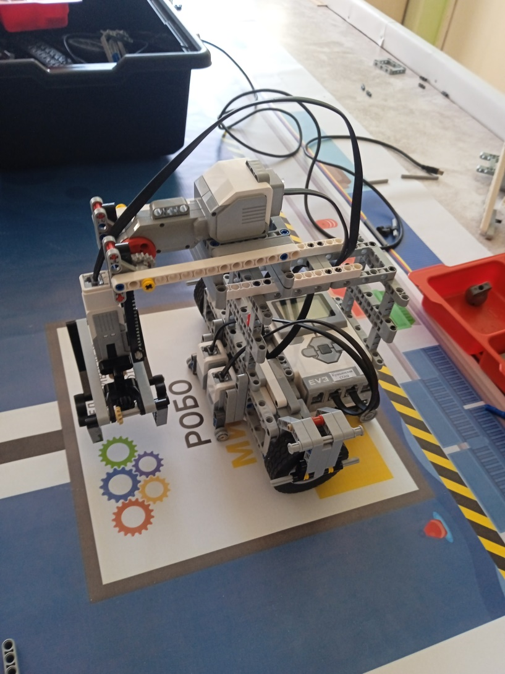
Робот.

Slide 3
Программа.
Sensor.SetMode(2,0)
Sensor.SetMode(3,0)
a = 1000
While Sensor.ReadPercent(3) > 10
if Sensor.ReadPercent(2) > 40 then
Motor.StartSync("BC",-50,35)
else
Motor.StartSync("BC",-35,50)
EndIf
EndWhile
Motor.Stop("BC","True")
Speaker.Tone(100,a,1000)
Program.Delay(1000)
Motor.MoveSync("BC",-25,25,270,"True")
Motor.MoveSync("BC",25,25,270,"True")

