Slide 1
CROBIH TEAM

Slide 2
TEAM MEMBERS
Our team has two team members:
- Jerko Ćubić(team captain and programmmer)
- Adi Jusupović(vice – captain and constructor)

Slide 3
JERKO ĆUBIĆ
Born in Croatia in 2004
Goes to 7. grade of Primary school Mate Lovraka in Zagreb
Started doing robotics 2 years ago
Works on software

Slide 4
ADI JUSUPOVIĆ
Born in Bosnia and Herzegovina in year 2002
01
Goes to 1. grade of High scool
02
Works on hardware
03

Slide 5
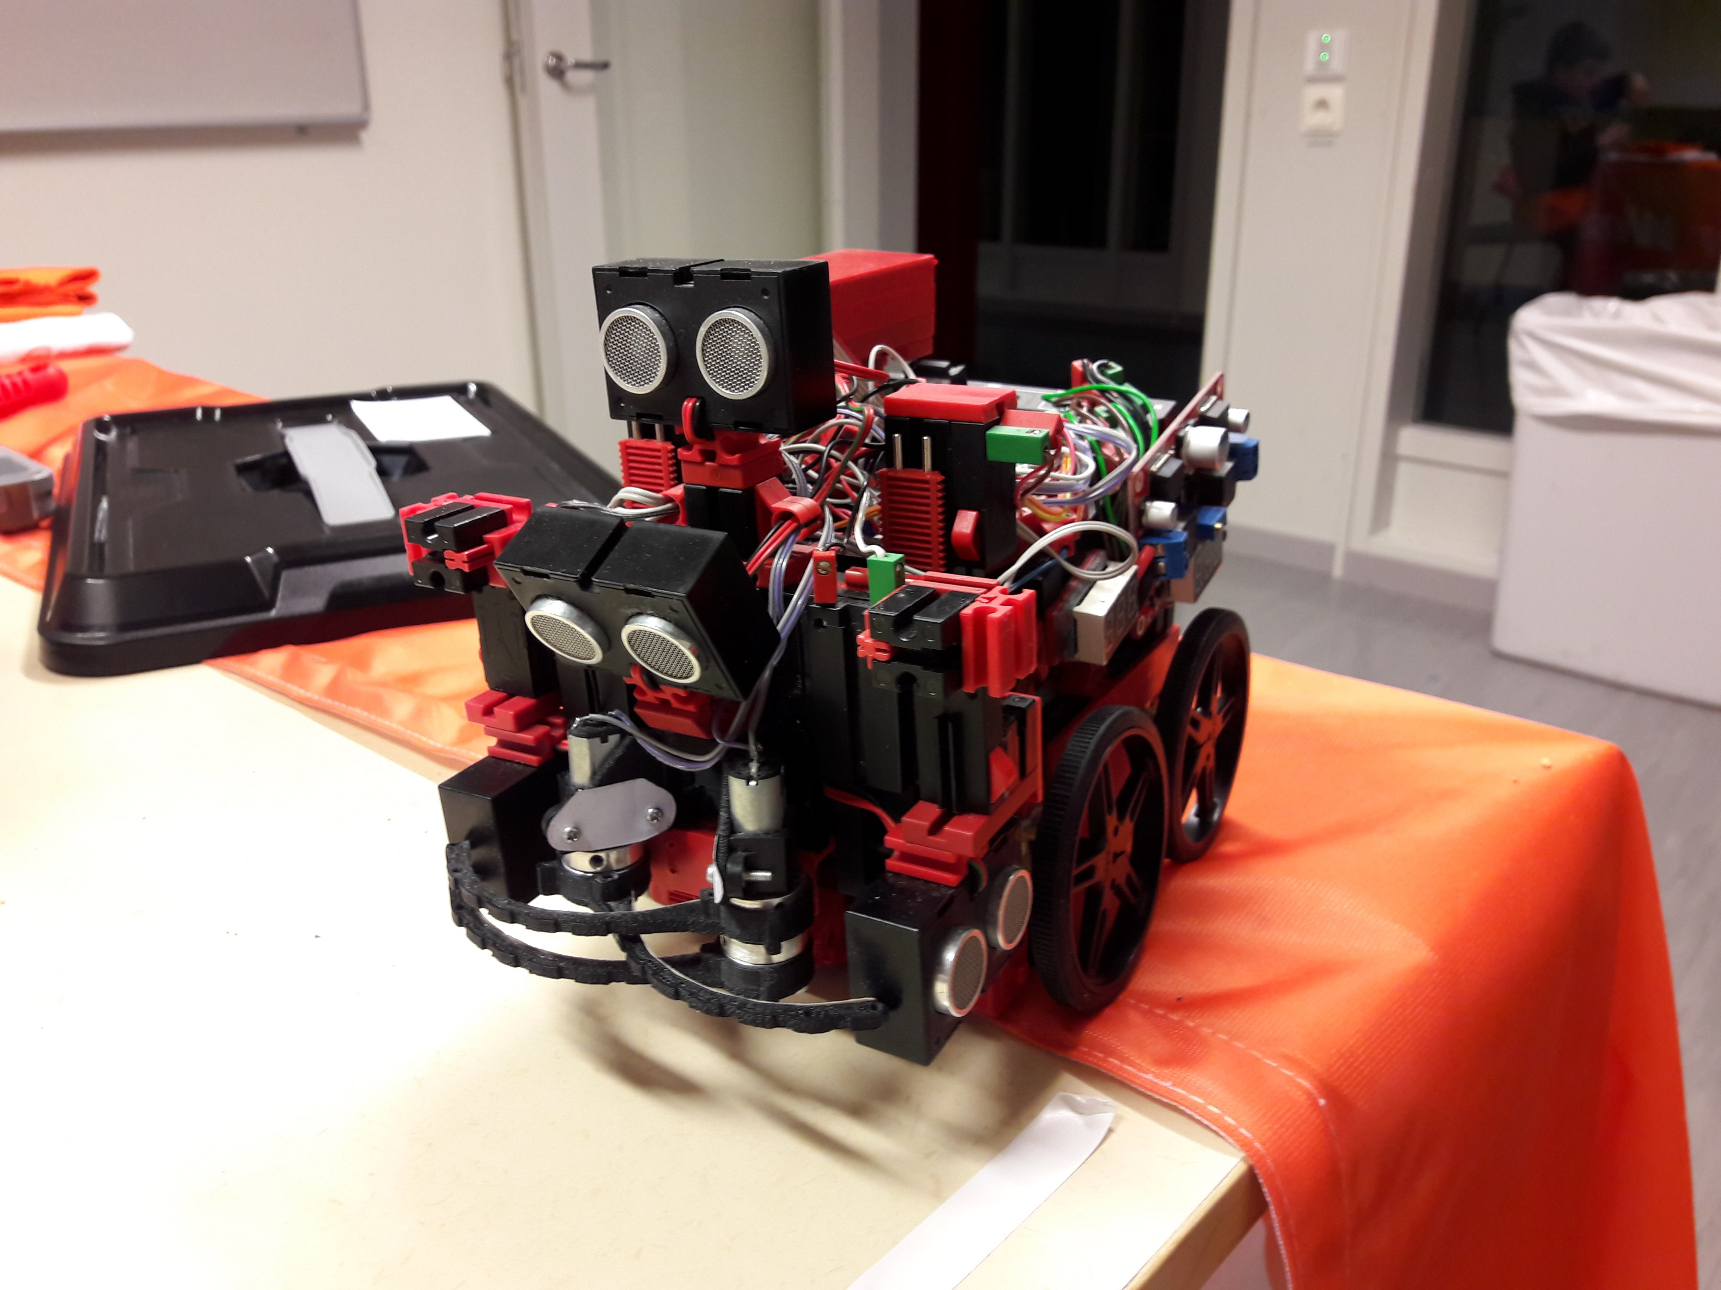
OLD VERSION OF OUR ROBOT
6 Pololu motors
2 Fischertechnik motors
TXT controller
4 Fischertechnik ultrasonic sensors
6 IR sensors
2 Fischertechnik color sensors
Li – Po battery
Robotic arm for collecting victims
Fischertechnik pushbutton switches

Slide 6
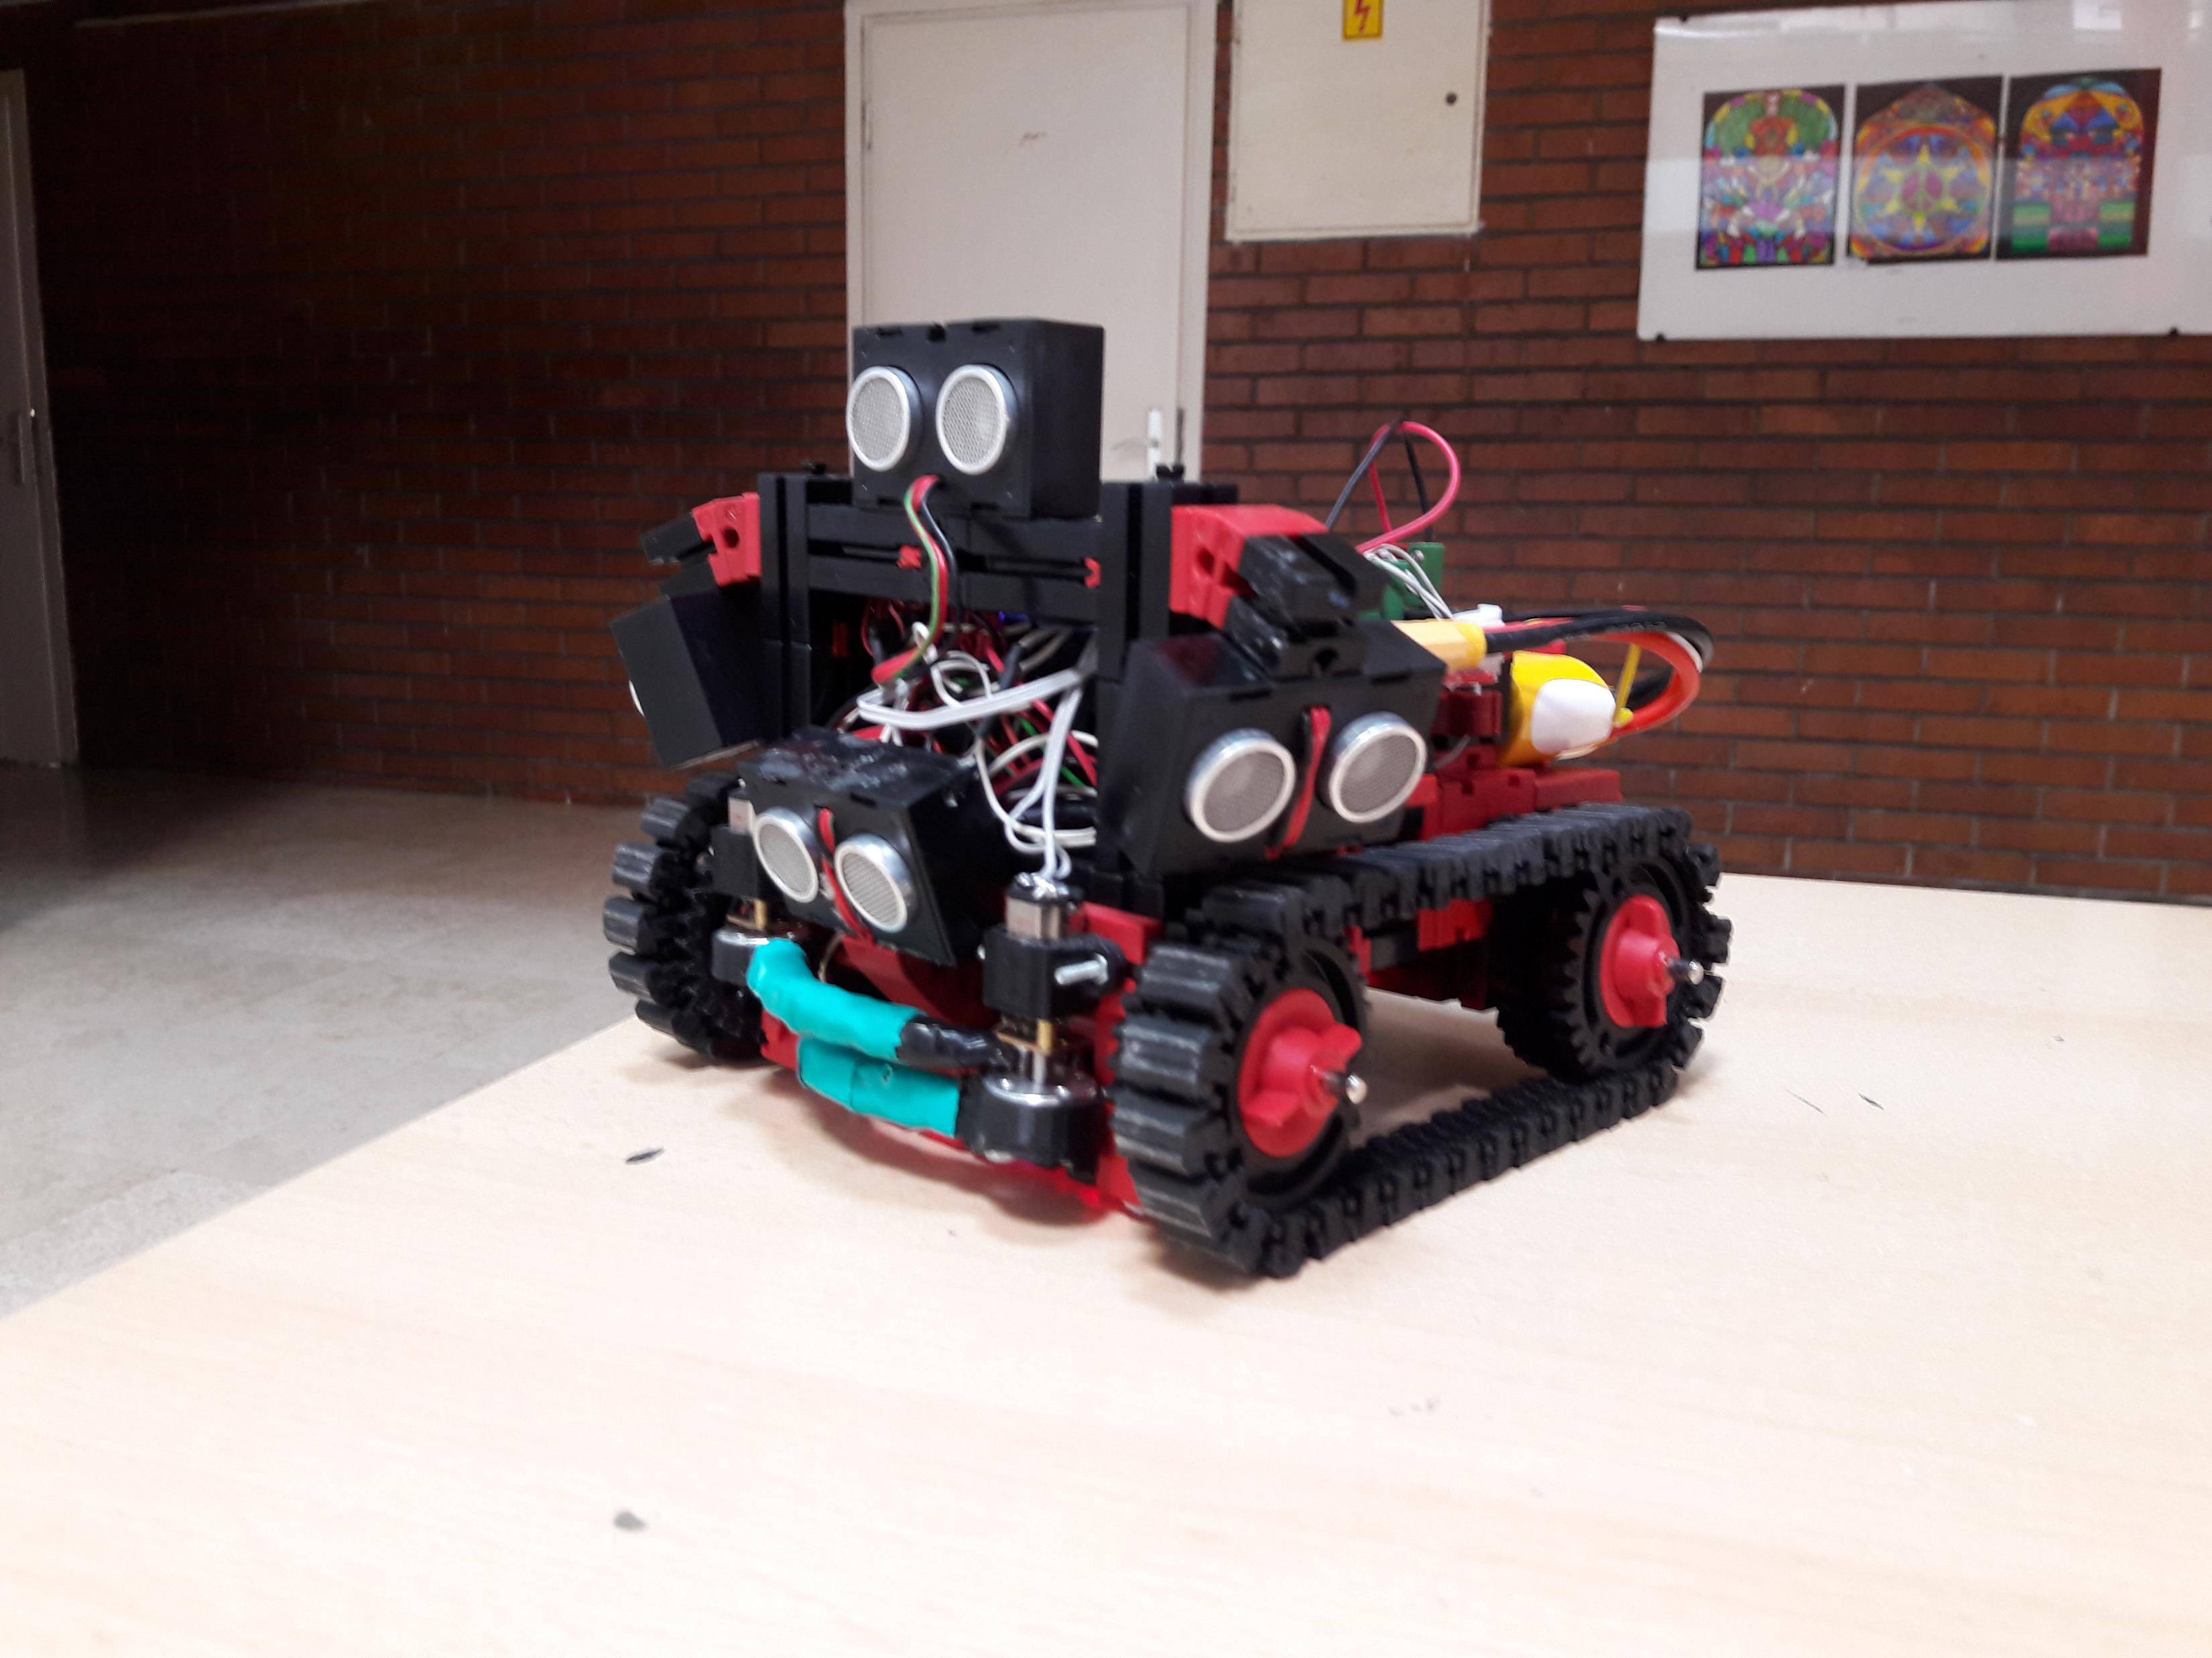
NEW VERSION OF OUR ROBOT
2 Pololu motors
2 Fischertechnik motors
TXT controller
4 Fischertechnik ultrasonic sensors
5 IR sensors
2 Fischertechnik color sensors
Robotic arm for collecting victims

Slide 7
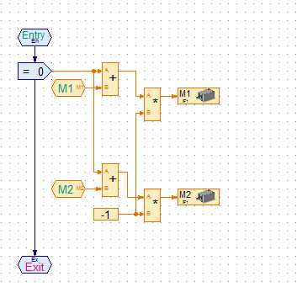
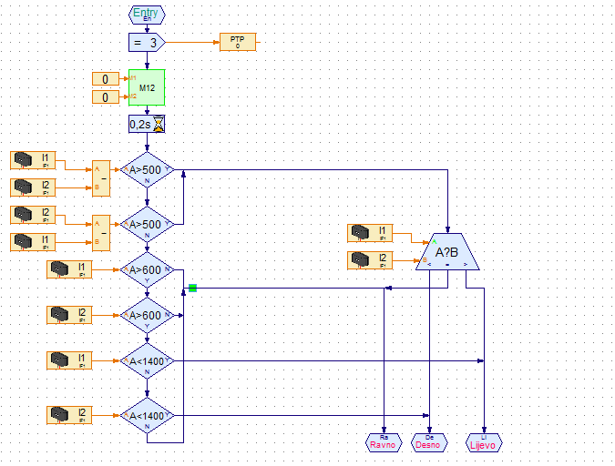
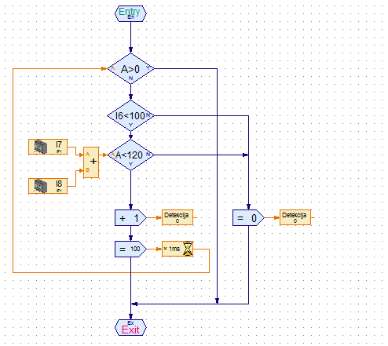
PARTS OF PROGRAM
We are programming in RoboPro program language

Slide 8
THANK YOU FOR YOUR ATTENTION

